Slide 1
Chapter 13
Capital Budgeting Techniques

Slide 2
After Studying Chapter 13, you should be able to:
Understand the payback period (PBP) method of project evaluation and selection, including its: (a) calculation; (b) acceptance criterion; (c) focus on liquidity rather than profitability.
Understand the three major discounted cash flow (DCF) methods of project evaluation and selection – internal rate of return (IRR), net present value (NPV), and profitability index (PI).
Explain the calculation, acceptance criterion.
Understand why ranking project proposals on the basis of IRR, NPV, and PI methods “may” lead to conflicts in rankings.
Describe the situations where ranking projects may be necessary and justify when to use either IRR, NPV, or PI rankings.
Understand how “sensitivity analysis” allows us to challenge the single-point input estimates used in traditional capital budgeting analysis.
Explain the role and process of project monitoring, including “progress reviews” and “post-completion audits.”

Slide 3
Capital Budgeting Techniques
  Project Evaluation and Selection
  Potential Difficulties
  Capital Rationing
  Project Monitoring
  Post-Completion Audit

Slide 4
Project Evaluation: Alternative Methods
  Payback Period (PBP)
  Internal Rate of Return (IRR)
  Net Present Value (NPV)
  Profitability Index (PI)
    Refer to the additional PowerPoint slides and the Excel spreadsheet “VW13E-13b.xlsx” for computer-based solutions.

Slide 5
Proposed Project Data
  Julie Miller is evaluating a new project for her firm, Basket Wonders (BW). She has determined that the after-tax cash flows for the project will be $10,000; $12,000; $15,000; $10,000; and $7,000, respectively, for each of the Years 1 through 5. The initial cash outlay will be $40,000.

Slide 6
Independent Project
For this project, assume that it is independent of any other potential projects that Basket Wonders may undertake.
Independent – A project whose acceptance (or rejection) does not prevent the acceptance of other projects under consideration.

Slide 7
Payback Period (PBP)
0 1 2 3 4 5
–40 K 10 K 12 K 15 K 10 K 7 K
PBP is the period of time required for the cumulative expected cash flows from an investment project to equal the initial cash outflow.

Slide 8
Payback Solution (#1)
(a)
0 1 2 3 4 5
(-b)
(d)
–40 K 10 K 12 K 15 K 10 K 7 K
(c)
10 K 22 K 37 K 47 K 54 K
Cumulative
Inflows
  PBP = a + ( b – c ) / d = 3 + (40 – 37) / 10 = 3 + (3) / 10 = 3.3 Years

Slide 9
PBP Acceptance Criterion
  The management of Basket Wonders has set a maximum PBP of 3.5 years for projects of this type.
  Should this project be accepted?
Yes! The firm will receive back the initial cash outlay in less than 3.5 years. [3.3 Years < 3.5 Year Max.]

Slide 10
Internal Rate of Return (IRR)
  IRR is the discount rate that equates the present value of the future net cash flows from an investment project with the project’s initial cash outflow.
CF₁ CF₂ CF_{n}
ICO =
+
+ . . . +
  (1 + IRR)¹ (1 + IRR)² (1 + IRR)^{n}

Slide 11
IRR Solution
$10,000 $12,000
$40,000 =
+
+
(1+IRR)¹ (1+IRR)²
$15,000 $10,000 $7,000
+
+
(1+IRR)³ (1+IRR)⁴ (1+IRR)⁵
Find the interest rate (IRR) that causes the discounted cash flows to equal $40,000.

Slide 12
IRR Solution (Try 10%)
$40,000 = $10,000(PVIF_{10%,1}) + $12,000(PVIF_{10%,2}) + $15,000(PVIF_{10%,3}) + $10,000(PVIF_{10%,4}) + $ 7,000(PVIF_{10%,5})
$40,000 = $10,000(0.909) + $12,000(0.826) + $15,000(0.751) + $10,000(0.683) + $ 7,000(0.621)
$40,000 = $9,090 + $9,912 + $11,265 + $6,830 + $4,347 = $41,444 [Rate is too low!!]

Slide 13
IRR Solution (Try 15%)
$40,000 = $10,000(PVIF_{15%,1}) + $12,000(PVIF_{15%,2}) + $15,000(PVIF_{15%,3}) + $10,000(PVIF_{15%,4}) + $ 7,000(PVIF_{15%,5})
$40,000 = $10,000(0.870) + $12,000(0.756) + $15,000(0.658) + $10,000(0.572) + $ 7,000(0.497)
$40,000 = $8,700 + $9,072 + $9,870 + $5,720 + $3,479 = $36,841 [Rate is too high!!]

Slide 14
IRR Solution (Interpolate)
0.10 $41,444
0.05 IRR $40,000 $4,603
0.15 $36,841
X $1,444 0.05 $4,603
X
$1,444
=

Slide 15
IRR Solution (Interpolate)
0.10 $41,444
0.05 IRR $40,000 $4,603
0.15 $36,841
X $1,444 0.05 $4,603
X
$1,444
=

Slide 16
IRR Solution (Interpolate)
0.10 $41,444
0.05 IRR $40,000 $4,603
0.15 $36,841
($1,444)(0.05) $4,603
X
$1,444
X =
X = 0.0157
IRR = 0.10 + 0.0157 = 0.1157 or 11.57%

Slide 17
IRR Acceptance Criterion
  The management of Basket Wonders has determined that the hurdle rate is 13% for projects of this type.
  Should this project be accepted?
No! The firm will receive 11.57% for each dollar invested in this project at a cost of 13%. [ IRR < Hurdle Rate ]

Slide 18
Net Present Value (NPV)
  NPV is the present value of an investment project’s net cash flows minus the project’s initial cash outflow.
CF₁ CF₂ CF_{n}
NPV =
+
+ . . . +
- ICO
  (1+k)¹ (1+k)² (1+k)^{n}

Slide 19
NPV Solution
Basket Wonders has determined that the appropriate discount rate (k) for this project is 13%.
$10,000 $12,000 $15,000
NPV =
+
+
+
(1.13)¹ (1.13)² (1.13)³
$10,000 $7,000
+
- $40,000
(1.13)⁴ (1.13)⁵

Slide 20
NPV Solution
NPV = $10,000(PVIF_{13%,1}) + $12,000(PVIF_{13%,2}) + $15,000(PVIF_{13%,3}) + $10,000(PVIF_{13%,4}) + $ 7,000(PVIF_{13%,5}) – $40,000
NPV = $10,000(0.885) + $12,000(0.783) + $15,000(0.693) + $10,000(0.613) + $ 7,000(0.543) – $40,000
NPV = $8,850 + $9,396 + $10,395 + $6,130 + $3,801 – $40,000
= - $1,428

Slide 21
NPV Acceptance Criterion
  The management of Basket Wonders has determined that the required rate is 13% for projects of this type.
  Should this project be accepted?
No! The NPV is negative. This means that the project is reducing shareholder wealth. [Reject as NPV < 0 ]

Slide 22
Profitability Index (PI)
  PI is the ratio of the present value of a project’s future net cash flows to the project’s initial cash outflow.
CF₁ CF₂ CF_{n}
PI =
+
+ . . . +
ICO
  (1+k)¹ (1+k)² (1+k)^{n}

Slide 23
PI Acceptance Criterion
  PI = $38,572 / $40,000
  = .9643
  Should this project be accepted?
No! The PI is less than 1.00. This means that the project is not profitable. [Reject as PI < 1.00 ]

Slide 24
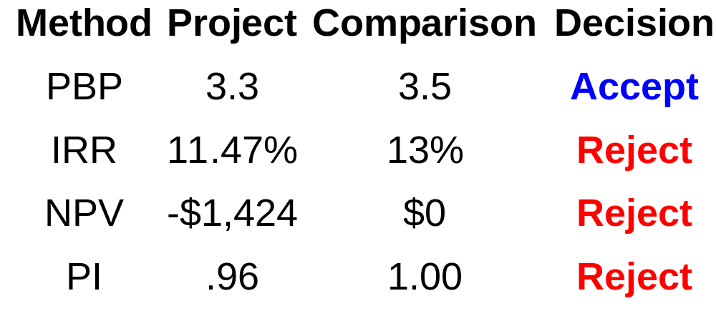
Evaluation Summary
Basket Wonders Independent Project

Slide 25
Other Project Relationships
Dependent – A project whose acceptance depends on the acceptance of one or more other projects.
Mutually Exclusive – A project whose acceptance prevents the acceptance of one or more alternative projects.

Slide 26
Potential Problems
Under Mutual Exclusivity
  Ranking of project proposals may create contradictory results.
      A. Scale of Investment
      B. Cash-flow Pattern
      C. Project Life

Slide 27
A. Scale Differences
  Compare a small (S) and a large (L) project.
NET CASH FLOWS
END OF YEAR
Project S Project L
0 -$100 -$100,000
1 0 0
2 $400 $156,250

Slide 28
A. Scale Differences
Calculate the PBP, IRR, NPV@10%, and PI@10%.
Which project is preferred? Why?
Project IRR NPV PI
S 100% $ 231 3.31
L 25% $29,132 1.29

Slide 29
B. Cash Flow Pattern
  Let us compare a decreasing cash-flow (D) project and an increasing cash-flow (I) project.
NET CASH FLOWS
END OF YEAR
Project D Project I
0 -$1,200 -$1,200
1 1,000 100
2 500 600
3 100 1,080

Slide 30
Cash Flow Pattern
Calculate the IRR, NPV@10%, and PI@10%.
Which project is preferred?
Project IRR NPV PI
D 23% $198 1.17
I 17% $198 1.17
?

Slide 31
C. Project Life Differences
  Let us compare a long life (X) project and a short life (Y) project.
NET CASH FLOWS
END OF YEAR
Project X Project Y
0 -$1,000 -$1,000
1 0 2,000
2 0 0
3 3,375 0

Slide 32
Project Life Differences
Calculate the PBP, IRR, NPV@10%, and PI@10%.
Which project is preferred? Why?
Project IRR NPV PI
?
X 50% $1,536 2.54
Y 100% $ 818 1.82

Slide 33
Capital Rationing
  Capital Rationing occurs when a constraint (or budget ceiling) is placed on the total size of capital expenditures during a particular period.
Example: Julie Miller must determine what investment opportunities to undertake for Basket Wonders (BW). She is limited to a maximum expenditure of $32,500 only for this capital budgeting period.

Slide 34
Available Projects for BW
  Project ICO IRR NPV PI
  A $ 500 18% $ 50 1.10 B 5,000 25 6,500 2.30 C 5,000 37 5,500 2.10 D 7,500 20 5,000 1.67 E 12,500 26 500 1.04 F 15,000 28 21,000 2.40 G 17,500 19 7,500 1.43 H 25,000 15 6,000 1.24

Slide 35
Choosing by IRRs for BW
  Project ICO IRR NPV PI
  C $ 5,000 37% $ 5,500 2.10 F 15,000 28 21,000 2.40 E 12,500 26 500 1.04 B 5,000 25 6,500 2.30
  Projects C, F, and E have the three largest IRRs.
  The resulting increase in shareholder wealth is $27,000 with a $32,500 outlay.

Slide 36
Choosing by NPVs for BW
  Project ICO IRR NPV PI
  F $15,000 28% $21,000 2.40 G 17,500 19 7,500 1.43 B 5,000 25 6,500 2.30
  Projects F and G have the two largest NPVs.
  The resulting increase in shareholder wealth is $28,500 with a $32,500 outlay.

Slide 37
Choosing by PIs for BW
  Project ICO IRR NPV PI
  F $15,000 28% $21,000 2.40 B 5,000 25 6,500 2.30 C 5,000 37 5,500 2.10 D 7,500 20 5,000 1.67 G 17,500 19 7,500 1.43
  Projects F, B, C, and D have the four largest PIs.
  The resulting increase in shareholder wealth is $38,000 with a $32,500 outlay.

Slide 38
Summary of Comparison
  Method Projects Accepted Value Added
  PI F, B, C, and D $38,000
  NPV F and G $28,500
  IRR C, F, and E $27,000
  PI generates the greatest increase in shareholder wealth when a limited capital budget exists for a single period.

Slide 39
Single-Point Estimate and Sensitivity Analysis
Sensitivity Analysis: A type of “what-if” uncertainty analysis in which variables or assumptions are changed from a base case in order to determine their impact on a project’s measured results (such as NPV or IRR).
Allows us to change from “single-point” (i.e., revenue, installation cost, salvage, etc.) estimates to a “what if” analysis
Utilize a “base-case” to compare the impact of individual variable changes
  E.g., Change forecasted sales units to see impact on the project’s NPV

Slide 40
Post-Completion Audit
  Post-completion Audit
  A formal comparison of the actual costs and benefits of a project with original estimates.
  Identify any project weaknesses
  Develop a possible set of corrective actions
  Provide appropriate feedback
  Result: Making better future decisions!

